Slide 1


Curso de Cobol - Cics

Slide 2
Curso de Cobol -CICS
CARACTERISTICAS GENERALES
Se tratará de un curso con una activa intervención de los participantes dado que el mismo estará basado en visualizar en la práctica la utilización de los recursos disponibles, previa introducción de la teoría correspondiente.

Slide 3
Curso de Cobol - CICS
OBJETIVOS
La mejor utilización de los recursos
Soluciones reales a problemas cotidianos
Fijar estrategias de programación para facilitar futuras modificaciones y permitir la re-utilización de códigos como base de nuevas aplicaciones
Mejora en la calidad del producto final

Slide 4
Curso de Cobol - CICS
ESTRUCTURA
1. ENVIRONMENT
2. INSTRUCCIONES
3. TECNICAS DE PROGRAMACION
4. PROGRAMAS EJEMPLOS

Slide 5
Curso de Cobol - CICS
ENVIRONMENT

Slide 6
Curso de Cobol - CICS
TABLAS
PCT Program Control Table
PPT Procesing Program Table
FCT File Control Table
PLT Program List Table
TCT Terminal Control Table
JCT Journal Control Table

Slide 7
Curso de Cobol - CICS
CEDA
+----------------------------------------------------------------------------------------+
¦ ¦
¦ ENTER ONE OF THE FOLLOWING ¦
¦ ¦
¦ ADd ¦
¦ ALter ¦
¦ APpend ¦
¦ CHeck ¦
¦ COpy ¦
¦ DEFine ¦
¦ DELete ¦
¦ DIsplay ¦
¦ Expand ¦
¦ Install ¦
¦ Lock ¦
¦ Move ¦
¦ REMove ¦
¦ REName ¦
¦ UNlock ¦
¦ USerdefine ¦
¦ View ¦
¦ SYSID=CICA APPLID=MYCICS ¦
¦ ¦
¦ PF 1 HELP 3 END 6 CRSR 9 MSG 12 CNCL ¦
+----------------------------------------------------------------------------------------+

Slide 8
Curso de Cobol - CICS
CEDA
+----------------------------------------------------------------------------------------+
¦ DEFINE |
¦ ENTER ONE OF THE FOLLOWING ¦
¦ ¦
¦ Connection ¦
¦ File ¦
¦ Lsrpool ¦
¦ Mapset ¦
¦ PARTItionset ¦
¦ PARTNer ¦
¦ PROFile ¦
¦ PROGram ¦
¦ Sessions ¦
¦ TErminal ¦
¦ TRANClass ¦
¦ TRANSaction ¦
¦ TYpeterm ¦
¦ ¦
¦ ¦
¦ SYSID=CICA APPLID=MYCICS ¦
¦ ¦
¦ PF 1 HELP 3 END 6 CRSR 9 MSG 12 CNCL ¦
¦ ¦
+----------------------------------------------------------------------------------------+

Slide 9
Curso de Cobol - CICS
CEDA
+----------------------------------------------------------------------------------------------------------+
¦ DEFINE MAPSET(NEW1) GROUP(AAA1) ¦
¦ OVERTYPE TO MODIFY CICS RELEASE = 0410 ¦
¦ CEDA DEFine Mapset( NEW1 ) ¦
¦ Mapset : NEW1 ¦
¦ Group : AAA1 ¦
¦ Description ==> ¦
¦ REsident ==> No No | Yes ¦
¦ USAge ==> Normal Normal | Transient ¦
¦ USElpacopy ==> No No | Yes ¦
¦ Status ==> Enabled Enabled | Disabled ¦
¦ RSl : 00 0-24 | Public ¦
¦ ¦
¦ ¦
¦ I New group AAA1 created. ¦
¦ SYSID=CICA APPLID=MYCICS ¦
¦ DEFINE SUCCESSFUL TIME: 14.03.13 DATE: 94.087 ¦
¦ PF 1 HELP 2 COM 3 END 6 CRSR 7 SBH 8 SFH 9 MSG 10 SB 11 SF 12 CNCL ¦
¦ ¦
+----------------------------------------------------------------------------------------------------------+

Slide 10
Curso de Cobol - CICS
CEMT
+---------------------------------------------------------------------------------------------------------------------+
¦ INQ |
¦ STATUS: ENTER ONE OF THE FOLLOWING OR HIT ENTER FOR DEFAULT ¦
¦ ¦
¦ AUTInstmodel Journalnum TRANSaction ¦
¦ AUTOinstall Line TRDumpcode ¦
¦ AUXtrace MODename TSqueue ¦
¦ Connection MONitor VOlume ¦
¦ DLidatabase Netname VTam ¦
¦ DSname PArtner ¦
¦ DUmpds PItrace ¦
¦ FEConnection PROFile ¦
¦ FENode PROGram ¦
¦ FEPOol STAtistics ¦
¦ FEPRopset STOrage ¦
¦ FETarget SYDumpcode ¦
¦ FIle SYStem ¦
¦ Gtftrace TAsk ¦
¦ INttrace TClass ¦
I RBatch TDqueue ¦
¦ IRC TErminal |
| SYSID=CI41 APPLID=IYAHZCCV ¦
¦ PF 1 HELP 3 END 9 MSG ¦
+---------------------------------------------------------------------------------------------------------------------+

Slide 11
Curso de Cobol - CICS
CEMT
+--------------------------------------------------------------------------------------------+
¦ CEMT IN FILE ¦
¦ STATUS: RESULTS - OVERTYPE TO MODIFY ¦
¦ Fil(DFHCSD ) Vsa Clo Une Rea Upd Add Bro Del ___ Sha ¦
¦ Dsn( WATTS.CICSCV.RXB1.CSD ) Max( 00000000 ) ¦
¦ ¦
¦ ¦
¦ ¦
¦ ¦
¦ ¦
¦ ¦
¦ ¦
¦ SYSID=CI41 APPLID=IYAHZCCV ¦
¦ PF 1 HELP 3 END 9 MSG ¦
+----------------------------------------------------------------------------------------------------------------------------+

Slide 12
Curso de Cobol - CICS
CECI
STATUS: ENTER ONE OF THE FOLLOWING
ABend DISAble ISsue RELease SUspend
ACquire DISCard Journal RESEtbr SYncpoint
ADdress DUmp LInk RESYnc Trace
ALlocate ENAble LOad RETRieve Unlock
ASKtime ENDbr Monitor RETUrn Verify
ASSign ENQ PErform REWrite WAIT
BIf ENTer POInt ROute WAITCics
BUild EXtract POP SENd WRITE
CAncel FEpi POSt SET WRITEQ
CHange FOrmattime PURge SIGNOFf Xctl
COLlect FREE PUSh SIGNON
CONNect FREEMain Query SPOOLClose
CONVerse GDs READ SPOOLOpen
DELAy GEtmain READNext SPOOLRead
DELETE Handle READPrev SPOOLWrite
DELETEQ IGnore READQ START
DEQ INquire RECeive STARTBr
PF 1 HELP 2 HEX 3 END 4 EIB 5 VAR 6 USER 9 MSG

Slide 13
Curso de Cobol - CICS
CECI
READ
STATUS: COMMAND SYNTAX CHECK NAME=
EXEC CICS READ
File()
< SYsid() >
( SEt() | Into() )
< Length() >
RIdfld()
< Keylength() < GEneric > >
< RBa | RRn | DEBRec | DEBKey >
< GTeq | Equal >
< Update < Token() > >
MESSAGES: 2 SEVERE
PF 1 HELP 2 HEX 3 END 4 EIB 5 VAR 6 USER 7 SBH 8 SFH 9 MSG 10 SB 11 SF

Slide 14
Curso de Cobol - CICS
CECI
READ FILE ('ABCD') INTO(&A) LENGTH(&B) RIDFLD(&C)
STATUS: COMMAND SYNTAX CHECK NAME=
EXEC CICS READ
File( 'ABCD ' )
< SYsid() >
( SEt() | Into() )
< Length() >
RIdfld()
< Keylength() < GEneric > >
< RBa | RRn | DEBRec | DEBKey >
< GTeq | Equal >
< Update < Token() > >
MESSAGES: 1 SEVERE 1 ERROR
PF 1 HELP 2 HEX 3 END 4 EIB 5 VAR 6 USER 7 SBH 8 SFH 9 MSG 10 SB 11 SF

Slide 15
Curso de Cobol - CICS
CECI
READ FILE ('ABCD') INTO(&A) LENGTH(&B) RIDFLD(&C)
SYNTAX MESSAGES
E Variable for RIDFLD does not exist or is null.
S Option RIDFLD has been omitted or specified with an invalid value. The
command cannot be executed.
PF 1 HELP 2 HEX 3 END 4 EIB 5 VAR 6 USER 7 SBH 8 SFH 10 SB 11 SF

Slide 16
Curso de Cobol - CICS
CECI
READ FILE ('ABCD') INTO(&A) LENGTH(&B) RIDFLD(&C)
VARIABLES LENGTH DATA
&DFHC +00016 THIS IS A SAMPLE
&DFHW +00046 EXEC CICS WRITEQ QUEUE('""CIA004') FROM(&DFHC)
&DFHR +00045 EXEC CICS READQ QUEUE('""CIA004') INTO(&DFHC)
&A +00000
&B H +00100
&C +00008 ABCD1234
PF 1 HELP 2 HEX 3 END 4 EIB 5 VAR 6 USER 9 MSG

Slide 17
Curso de Cobol - CICS
CECI
READ FILE ('ABCD') INTO(&A) LENGTH(&B) RIDFLD(&C)
STATUS: COMMAND EXECUTION COMPLETE NAME=
EXEC CICS READ
File( X'C1C2C3C440404040' )
< SYsid() >
( SEt() | Into( X'' ) )
< Length( X'0000' ) >
RIdfld( X'C1C2C3C4F1F2F3F4' )
< Keylength() < GEneric > >
< RBa | RRn | DEBRec | DEBKey >
< GTeq | Equal >
< Update < Token() > >
RESPONSE: FILENOTFOUND EIBRESP=X'0000000C' EIBRESP2=X'00000001'
PF 1 HELP 2 HEX 3 END 4 EIB 5 VAR 6 USER 7 SBH 8 SFH 9 MSG 10 SB 11 SF

Slide 18
Curso de Cobol - CICS
CEDF
TRANSACTION: IR00 PROGRAM: IRO0000 TASK: 0000623 APPLID: ARGTEST1 DISPLAY: 00
STATUS: PROGRAM INITIATION
EIBTIME = 112014
EIBDATE = 0098232
EIBTRNID = 'IR00'
EIBTASKN = 623
EIBTRMID = 'A004'
EIBCPOSN = 27
EIBCALEN = 0
EIBAID = X'7D' AT X'002020EA'
EIBFN = X'0000' AT X'002020EB'
EIBRCODE = X'000000000000' AT X'002020ED'
EIBDS = '........'
+ EIBREQID = '........'
ENTER: CONTINUE
PF1 : UNDEFINED PF2 : SWITCH HEX/CHAR PF3 : END EDF SESSION
PF4 : SUPPRESS DISPLAYS PF5 : WORKING STORAGE PF6 : USER DISPLAY
PF7 : SCROLL BACK PF8 : SCROLL FORWARD PF9 : STOP CONDITIONS
PF10: PREVIOUS DISPLAY PF11: UNDEFINED PF12: UNDEFINED

Slide 19
Curso de Cobol - CICS
CEDF
TRANSACTION: IR00 PROGRAM: IRO0000 TASK: 0000623 APPLID: ARGTEST1 DISPLAY: 00
STATUS: PROGRAM INITIATION
EIBTIME = X'0112014C' AT X'002020D0'
EIBDATE = X'0098232F' AT X'002020D4'
EIBTRNID = X'C9D9F0F0' AT X'002020D8'
EIBTASKN = X'0000623C' AT X'002020DC'
EIBTRMID = X'C1F0F0F4' AT X'002020E0'
EIBCPOSN = X'001B' AT X'002020E6'
EIBCALEN = X'0000' AT X'002020E8'
EIBAID = X'7D' AT X'002020EA'
EIBFN = X'0000' AT X'002020EB'
EIBRCODE = X'000000000000' AT X'002020ED'
EIBDS = X'0000000000000000' AT X'002020F3'
+ EIBREQID = X'0000000000000000' AT X'002020FB'
ENTER: CONTINUE
PF1 : UNDEFINED PF2 : SWITCH HEX/CHAR PF3 : END EDF SESSION
PF4 : SUPPRESS DISPLAYS PF5 : WORKING STORAGE PF6 : USER DISPLAY
PF7 : SCROLL BACK PF8 : SCROLL FORWARD PF9 : STOP CONDITIONS
PF10: PREVIOUS DISPLAY PF11: UNDEFINED PF12: UNDEFINED

Slide 20
Curso de Cobol - CICS
CEDF
TRANSACTION: IR00 PROGRAM: IRO0000 TASK: 0000623 APPLID: ARGTEST1 DISPLAY: 00
STATUS: COMMAND EXECUTION COMPLETE
EXEC CICS START
TRANSID ('IR09')
INTERVAL (0)
FROM ('1.. .. '...)
LENGTH (5120)
TERMID ('A004')
OFFSET:X'000430' LINE:00158 EIBFN=X'1008'
RESPONSE: NORMAL EIBRESP=0
ENTER: CONTINUE
PF1 : UNDEFINED PF2 : SWITCH HEX/CHAR PF3 : END EDF SESSION
PF4 : SUPPRESS DISPLAYS PF5 : WORKING STORAGE PF6 : USER DISPLAY
PF7 : SCROLL BACK PF8 : SCROLL FORWARD PF9 : STOP CONDITIONS
PF10: PREVIOUS DISPLAY PF11: UNDEFINED PF12: ABEND USER TASK

Slide 21
Curso de Cobol - CICS
CEDF
TRANSACTION: IR01 PROGRAM: IRO0001 TASK: 0000890 APPLID: ARGTEST1 DISPLAY: 00
STATUS: COMMAND EXECUTION COMPLETE
EXEC CICS SEND MAP
MAP ('SCN0001')
FROM ('............... 0... ...20/08/98..'...)
LENGTH (1179)
MAPSET ('IRM0001')
CURSOR (-1)
TERMINAL
ERASE
OFFSET:X'001332' LINE:00545 EIBFN=X'1804'
RESPONSE: NORMAL EIBRESP=0
ENTER: CONTINUE
PF1 : UNDEFINED PF2 : SWITCH HEX/CHAR PF3 : END EDF SESSION
PF4 : SUPPRESS DISPLAYS PF5 : WORKING STORAGE PF6 : USER DISPLAY
PF7 : SCROLL BACK PF8 : SCROLL FORWARD PF9 : STOP CONDITIONS
PF10: PREVIOUS DISPLAY PF11: UNDEFINED PF12: ABEND USER TASK

Slide 22
Curso de Cobol - CICS
CEDF
TRANSACTION: IR01 PROGRAM: IRO0001 TASK: 0000890 APPLID: ARGTEST1 DISPLAY: 00
STATUS: COMMAND EXECUTION COMPLETE
EXEC CICS SEND MAP
MAP (X'E2C3D5F0F0F0F1') AT X'001E4611'
FROM (X'0000000000000000048F00000000004040F0000000404040'...) AT X'09809AD0'
LENGTH (X'049B') AT X'001E461A'
MAPSET (X'C9D9D4F0F0F0F1') AT X'001E4623'
CURSOR (X'FFFF') AT X'001E462C'
TERMINAL
ERASE
OFFSET:X'001332' LINE:00545 EIBFN=X'1804'
RESPONSE: NORMAL EIBRESP=X'00000000'
ENTER: CONTINUE
PF1 : UNDEFINED PF2 : SWITCH HEX/CHAR PF3 : END EDF SESSION
PF4 : SUPPRESS DISPLAYS PF5 : WORKING STORAGE PF6 : USER DISPLAY
PF7 : SCROLL BACK PF8 : SCROLL FORWARD PF9 : STOP CONDITIONS
PF10: PREVIOUS DISPLAY PF11: UNDEFINED PF12: ABEND USER TASK

Slide 23
Curso de Cobol - CICS
CEDF
TRANSACTION: IR01 PROGRAM: IRO0001 TASK: 0000890 APPLID: ARGTEST1 DISPLAY: 00
ADDRESS: 09808658 WORKING STORAGE
09808650 000000 5C5C5C40 E6D6D9D2 ........*** WORK
09808660 000008 C9D5C740 E2E3D6D9 C1C7C540 5C5C5C40 ING STORAGE ***
09808670 000018 00311260 1079150C F0F0F0F0 40404040 ...-....0000
09808680 000028 40808660 00001B88 5C5C5C5C 40C1D9C5 .f-...h**** ARE
09808690 000038 C140C4C5 40E3E2E2 40404040 5C5C5C5C A DE TSS ****
098086A0 000048 C7D9C1F0 F0F4F0F1 C9D9F0F1 C9D9D6F0 GRA00401IR01IRO0
098086B0 000058 F0F0F140 C9D9D4F0 F0F0F140 E2C3D5F0 001 IRM0001 SCN0
098086C0 000068 F0F0F140 40404040 14004040 40404040 001 ..
098086D0 000078 F1000C40 40404040 40404040 40404040 1..
098086E0 000088 40404040 40404040 40404040 40404040
098086F0 000098 40000C40 40404040 40404040 40404040 ..
09808700 0000A8 40404040 40404040 40404040 40404040
09808710 0000B8 40404040 40404040 40000CC9 D9F0F140 ..IR01
09808720 0000C8 40404040 40404040 40404040 40404040
09808730 0000D8 40404040 40404040 40404040 40404040
09808740 0000E8 40404040 40404040 40404040 40F04040 0
ENTER: CURRENT DISPLAY
PF1 : UNDEFINED PF2 : BROWSE TEMP STORAGE PF3 : UNDEFINED
PF4 : EIB DISPLAY PF5 : INVOKE CECI PF6 : USER DISPLAY
PF7 : SCROLL BACK HALF PF8 : SCROLL FORWARD HALF PF9 : UNDEFINED
PF10: SCROLL BACK FULL PF11: SCROLL FORWARD FULL PF12: REMEMBER DISPLAY

Slide 24
Curso de Cobol - CICS
CEDF
TRANSACTION: IR01 PROGRAM: IRO0001 TASK: 0000890 APPLID: ARGTEST1 DISPLAY: 00
ADDRESS: 09809AD0 WORKING STORAGE+X'001478'
09809AD0 000000 00000000 00000000 048F0000 00000040 ...............
09809AE0 000010 40F00000 00404040 40404040 40404040 0...
09809AF0 000020 40404040 40404040 40404040 40404040
09809B00 000030 40404000 0000F2F0 61F0F861 F9F80000 ...20/08/98..
09809B10 000040 004040F0 00000040 40404040 40404040 . 0...
09809B20 000050 40404040 40404040 40404040 40404040
09809B30 000060 40404040 40000000 F1F17AF2 F47AF3F9 ...11:24:39
09809B40 000070 00000000 00000000 00000000 00000000 ................
09809B50 000080 00000000 00000000 00000000 00000000 ................
09809B60 000090 00000000 00000000 00000000 00000000 ................
09809B70 0000A0 00000000 00000000 00000000 00000000 ................
09809B80 0000B0 00000000 00000000 00000000 00000000 ................
09809B90 0000C0 00000000 00000000 00000000 00000000 ................
09809BA0 0000D0 00000000 00000000 00000000 00000000 ................
09809BB0 0000E0 00000000 00000000 00000000 00000000 ................
09809BC0 0000F0 00000000 00000000 00000000 00000000 ................
ENTER: CURRENT DISPLAY
PF1 : UNDEFINED PF2 : BROWSE TEMP STORAGE PF3 : UNDEFINED
PF4 : EIB DISPLAY PF5 : INVOKE CECI PF6 : USER DISPLAY
PF7 : SCROLL BACK HALF PF8 : SCROLL FORWARD HALF PF9 : UNDEFINED
PF10: SCROLL BACK FULL PF11: SCROLL FORWARD FULL PF12: REMEMBER DISPLAY

Slide 25
Curso de Cobol - CICS
CEDF
TRANSACTION: IR01 PROGRAM: IRO0001 TASK: 0000890 APPLID: ARGTEST1 DISPLAY: 00
STATUS: COMMAND EXECUTION COMPLETE
EXEC CICS SEND MAP
MAP (X'E2C3D5F0F0F0F1') AT X'001E4611'
FROM (X'0000000000000000048F00000000004040F0000000404040'...) AT X'09809AD0'
LENGTH (X'049B') AT X'001E461A'
MAPSET (X'C9D9D4F0F0F0F1') AT X'001E4623'
CURSOR (X'FFFF') AT X'001E462C'
TERMINAL
ERASE
OFFSET:X'001332' LINE:00545 EIBFN=X'1804'
RESPONSE: NORMAL EIBRESP=X'00000000'
ENTER ABEND CODE AND REQUEST ABEND AGAIN REPLY:
ENTER: CONTINUE
PF1 : UNDEFINED PF2 : SWITCH HEX/CHAR PF3 : END EDF SESSION
PF4 : SUPPRESS DISPLAYS PF5 : WORKING STORAGE PF6 : USER DISPLAY
PF7 : SCROLL BACK PF8 : SCROLL FORWARD PF9 : STOP CONDITIONS
PF10: PREVIOUS DISPLAY PF11: UNDEFINED PF12: ABEND USER TASK

Slide 26
Curso de Cobol - CICS
CEDF
TRANSACTION: IR01 PROGRAM: DFHEDFX TASK: 0000890 APPLID: ARGTEST1 DISPLAY: 00
STATUS: AN ABEND HAS OCCURRED
EIBTIME = X'0112439F' AT X'002010D0'
EIBDATE = X'0098232F' AT X'002010D4'
EIBTRNID = X'C9D9F0F1' AT X'002010D8'
EIBTASKN = X'0000890C' AT X'002010DC'
EIBTRMID = X'C1F0F0F4' AT X'002010E0'
EIBCPOSN = X'05E7' AT X'002010E6'
EIBCALEN = X'0000' AT X'002010E8'
EIBAID = X'7D' AT X'002010EA'
EIBFN = X'1804' SEND AT X'002010EB'
EIBRCODE = X'000000000000' AT X'002010ED'
EIBDS = X'0000000000000000' AT X'002010F3'
+ EIBREQID = X'0000000000000000' AT X'002010FB'
ABEND : LLLL
ENTER: CONTINUE
PF1 : UNDEFINED PF2 : SWITCH HEX/CHAR PF3 : END EDF SESSION
PF4 : SUPPRESS DISPLAYS PF5 : WORKING STORAGE PF6 : USER DISPLAY
PF7 : SCROLL BACK PF8 : SCROLL FORWARD PF9 : STOP CONDITIONS
PF10: PREVIOUS DISPLAY PF11: UNDEFINED PF12: UNDEFINED

Slide 27
Curso de Cobol - CICS
Conversacional Vs. Pseudo-Conversacional
Conversacional: Es aquel programa que queda activo mientras espera la acción del operador.
Pseudo-Conversacional: Es aquel que cuando necesita una intervención del operador devuelve el control a CICS y se auto-llama para volver a arrancar cuando el operador termina su acción.

Slide 28
Curso de Cobol - CICS
Conversacional Vs. Pseudo-Conversacional
Conversacional: No liberación de Recursos
No necesita Commarea
No libera Working-Storage
Pseudo-Conversacional: Libera los recursos
Los datos se deben pasar por commarea
Pierde la Working-Storage

Slide 29
Curso de Cobol - CICS
Commarea - Communication Area
Se utiliza para pasar información de un programa a otro
En el programa llamado tiene que estar definido el espacio en la Linkage Section
Cuando el programa llamado comienza podemos encontrar la longitud de la commarea en el EIBCALEN

Slide 30
Curso de Cobol - CICS
Commarea - Communication Area
WORKING-STORAGE SECTION.
01 AREA-DE-COMMAREA.
05 LK-FASE PIC X.
05 LK-SUB-FASE PIC X.
05 LK-RESTO PIC X(4094).
…...
LINKAGE SECTION.
01 DFHCOMMAREA PIC X(4096).

Slide 31
Curso de Cobol - CICS
Registros EIB
EIBAID Pic X(1) PF de la última pantalla recibida
EIBCALEN Pic S9(4) Comp Longitud de la commarea recibida
EIBCPOSN PIC S9(4) Comp Posición del cursor
EIBDATE Pic S9(7) Comp-3 Fecha donde se inició la task con un formato (0CYYDDD+) donde C indica la centuria 0=1900 / 1=2000
EIBRESP - EIBRESP2 PIC S9(8) COMP Código de respuesta de la última función ejecutada
EIBTIME PIC S9(7) COMP-3 Hora de comienzo de la transacción en formato (0HHMMSS+).
EIBTRMID PIC X(4) Identificación de la terminal
EIBTRNID PIC X(4) Código de transacción de CICS

Slide 32
Curso de Cobol - CICS
BMS - Basic Mapping Support
Es una interfase entre el CICS y los programas de aplicación
Permite mover streams desde y hacia la terminal, logrando que el dispositivo físico y su formato sea independiente del programa de aplicación

Slide 33
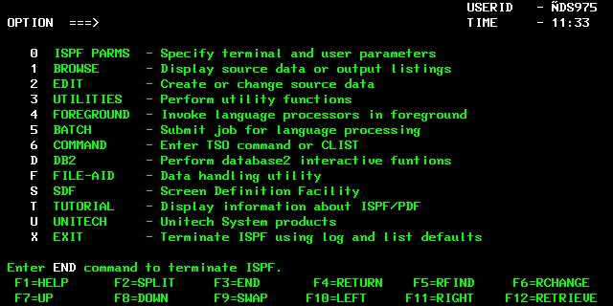
Curso de Cobol -CICS

Slide 34
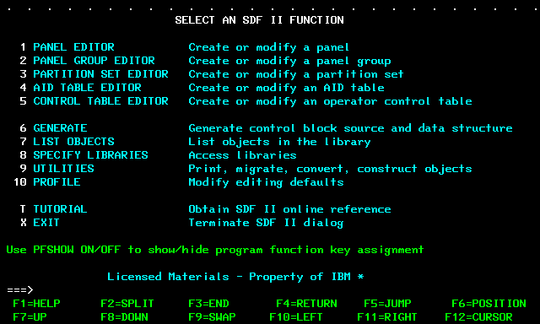
Curso de Cobol -CICS

Slide 35
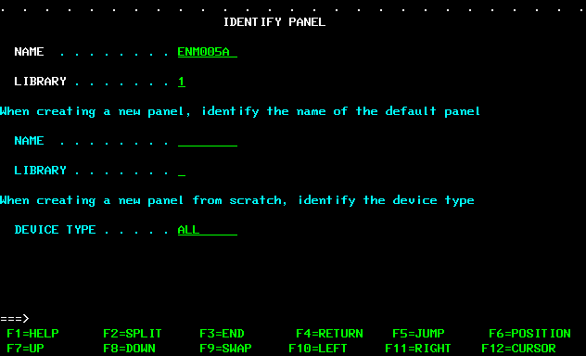
Curso de Cobol -CICS

Slide 36
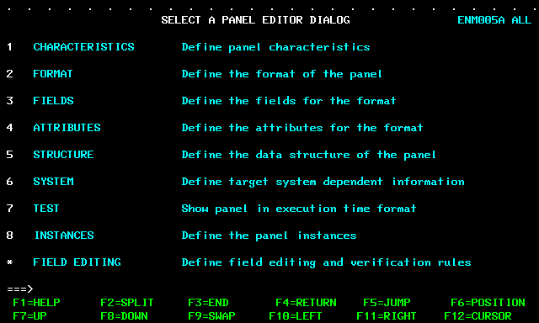
Curso de Cobol -CICS

Slide 37
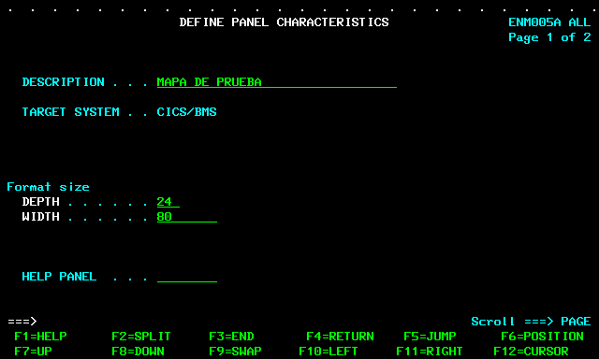
Curso de Cobol -CICS

Slide 38
Curso de Cobol -CICS

Slide 39
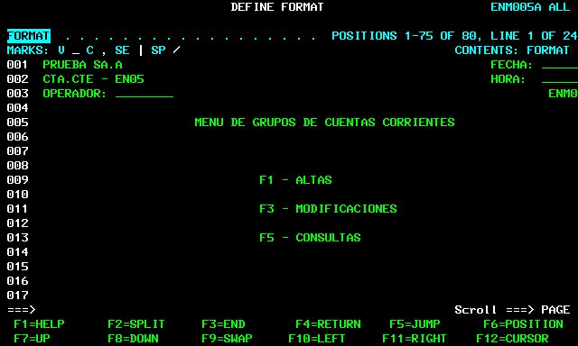
Curso de Cobol -CICS

Slide 40
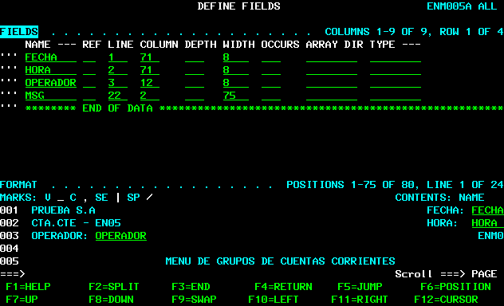
Curso de Cobol -CICS

Slide 41
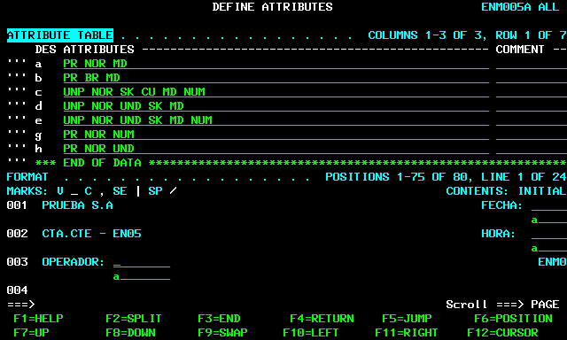
Curso de Cobol -CICS

Slide 42
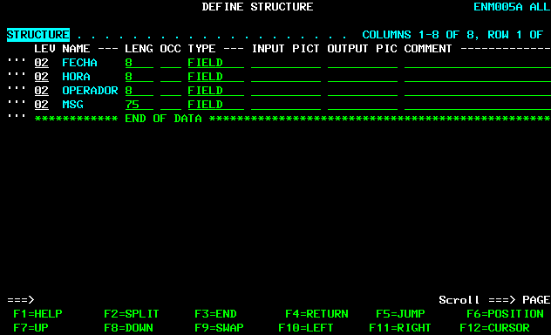
Curso de Cobol -CICS

Slide 43
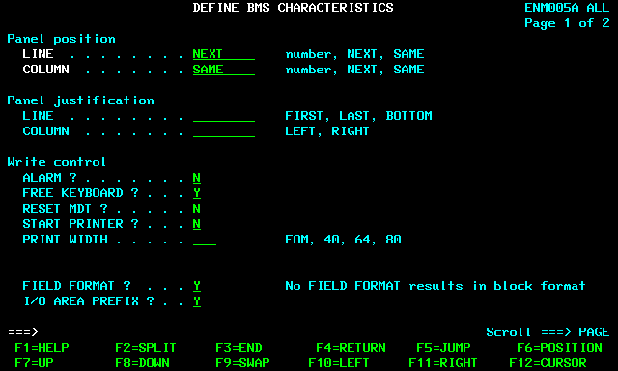
Curso de Cobol -CICS

Slide 44
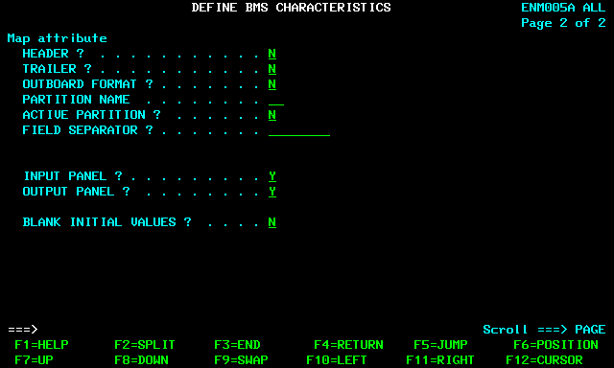
Curso de Cobol -CICS

Slide 45
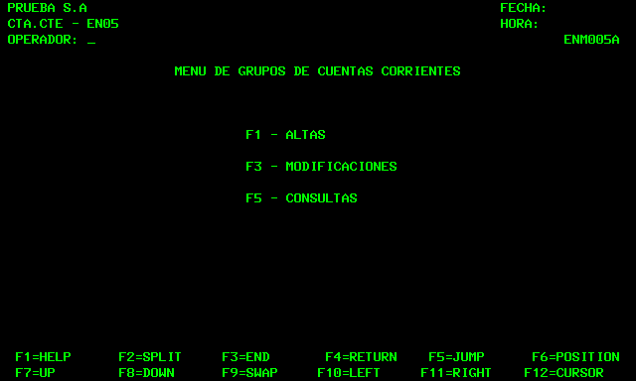
Curso de Cobol -CICS

Slide 46
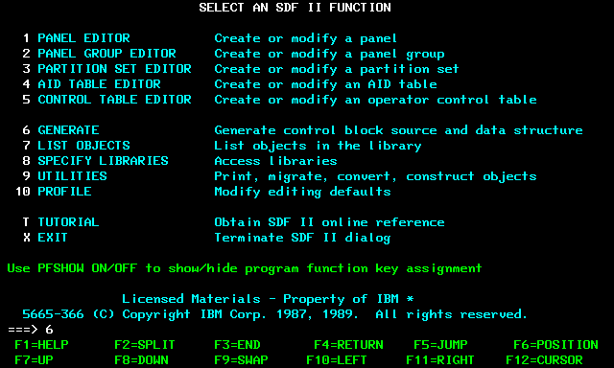
Curso de Cobol -CICS

Slide 47
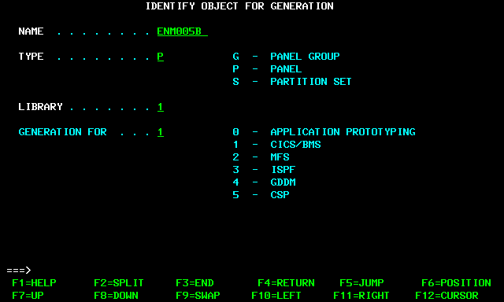
Curso de Cobol -CICS

Slide 48
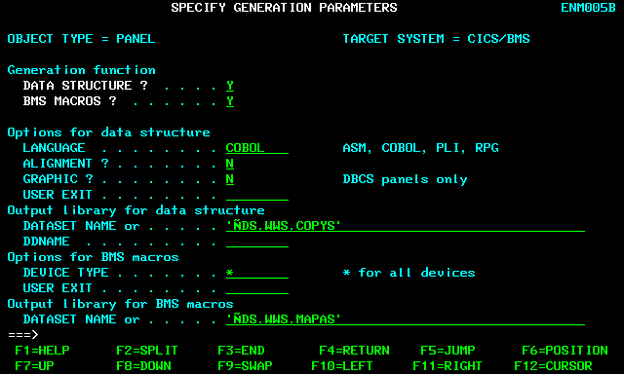
Curso de Cobol -CICS

Slide 49
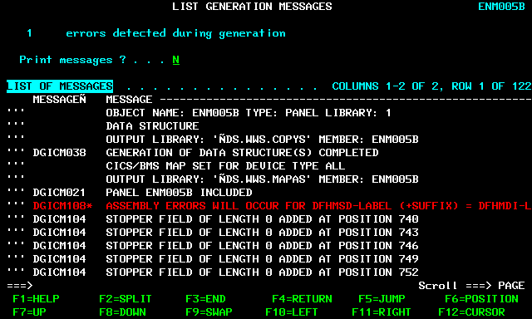
Curso de Cobol -CICS

Slide 50
Curso de Cobol - CICS
Mapas
Mapset definition macro (DFHMSD)
Map definition macro (DFHMDI)
Field definition macro (DFHMDF)
Ending a mapset definition

Slide 51
Curso de Cobol - CICS
Mapas
DFHMSD TYPE=MAP
-MODE=- -CURSLOC=
IN +-YES-+
INOUT +-OFF-------+
HILIGHT=
BLINK
REVERSE
UNDERLINE-+
LANG= VALIDN=
COBOL-- MUSTFILL--¦
COBOL2- MUSTENTER-¦
PLI TRIGGER---+
C
TERM=
SUFFIX=n--
CTRL=
PRINT
ALARM
DFHMSD TYPE=FINAL

Slide 52
Curso de Cobol - CICS
Mapas
--map--DFHMDI---------------------------------------------------------->
+-SIZE=(line,column)------ +-PS=---BASE--------------------
+-TERM=type--------------- +-psid-+
¦
+-CTRL=(--------------)- +-VALIDN=-----------------------
+-PRINT--¦ +-MUSTFILL-
+-length-¦ +-MUSTENTER
+-FREEKB +-TRIGGER---+
+-ALARM-- +-COLUMN=number------------
+-FRSET--+ +-LINE=number------------------
+-NO------+ +-FIELDS=NO--------------------
+-EXTATT=-+---------+-----
+-MAPONLY- +--MAPATTS=(attr)----------
+-YES-----+
+-DEFAULT-+ +--DSATTS=(attr)----------------
+-COLOR=-+---------+------ +-OUTLINE=---BOX------------
+-color---+
+-NO--+
+-CURSLOC=-+-----+--------
+-YES-+
+-OFF-------+ -
+-HILIGHT=-+-----------+--+
+-BLINK----- +
+-REVERSE--- +-SOSI=-+-----+-----------------
+-UNDERLINE-+ +-YES-+
+-YES-+
+-JUSTIFY=BOTTOM----------------+

Slide 53
Curso de Cobol - CICS
Mapas
>>-----------DFHMDF +-fld-+
+-POS=---number-
+-(line,column)-+
+-LENGTH=number
+-JUSTIFY=(-----------------------------)
+-LEFT--¦ +-,---BLANK----+
+-RIGHT-+ +-ZERO--+
+---INITIAL='char-data'-
+-ATTRB=(-+------------------+-------------------------------)-¦
+-PROT- +-UNPROT +-BRT- +-,NUM- +-NORM-
+-,DET +-DRK + IC +-,FSET-+ +-DEFAULT-
+-COLOR=-+---------+---
+-color--- + BASE-
+-HILIGHT=-+-----------+---------------------------------------¦
+-BLINK +-REVERSE +-UNDERLINE-+
+-VALIDN=(-----------------)-----------------------------------¦
+-MUSTFILL +-MUSTENTER +-TRIGGER
+-GRPNAME=group-name
+-OCCURS=number
+-PICIN='value'------------------------------------------------¦
+-PICOUT='value'-----------------------------------------------¦

Slide 54
Curso de Cobol - CICS
Mapas
MAPSET DFHMSD....
MAP DFHMDI.... .
DD DFHMDF GRPNAME=DATE,POS=40,
LENGTH=2,ATTRB=...
MM DFHMDF GRPNAME=DATE,POS=46,
LENGTH=2
YY DFHMDF GRPNAME=DATE,POS=52,
LENGTH=2
FIELD DFHMDF LENGTH=5,COLOR=GREEN,...
DFHMSD TYPE=FINAL

Slide 55
Curso de Cobol - CICS
Mapas
Generación de Copy
Input / Input-Output
Field
Atributo Pic X(01)
Longitud Pic S9(04) Comp
Campo Pic …...

Slide 56
Curso de Cobol - CICS
Instrucciones CICS dentro de un programa COBOL
EXEC CICS ………….
…………
END-EXEC
El Pre-Compilador convierte estas instrucciones en una serie de instrucciones COBOL

Slide 57
Curso de Cobol - CICS
Instrucciones CICS dentro de un programa COBOL
EXEC CICS RECEIVE MAP('A') END-EXEC.
LUEGO DEL PRE-COMPILADOR SERA:
MOVE ' ' TO DFHEIV0.
MOVE 'A' TO DFHC0070.
CALL 'DFHEI1' USING DFHEIV0 DFHC0070 AI.

Slide 58
Curso de Cobol - CICS
INSTRUCCIONES

Slide 59
Curso de Cobol - CICS
START
EXEC CICS START TRANSID(name)
INTERVAL(0)
INTERVAL(hhmmss)
TIME(hhmmss)
AFTER HOURS(data-value)
MINUTES(data-value)
SECONDS(data-value)
AT HOURS(data-value) MINUTES(data-value)
SECONDS(data-value)
REQID(name)
FROM(data-area)
LENGTH(data-value)
FMH
TERMID(name)

Slide 60
Curso de Cobol - CICS
START (Cont.)
SYSID(systemname)
RTRANSID(name)
USERID(data-value)
RTERMID(name)
QUEUE(name)
NOCHECK
PROTECT
ATTACH
Condiciones de Error Posibles:
INVREQ, IOERR, ISCINVREQ, LENGERR, NOTAUTH, SYSIDERR, TERMIDERR,
TRANSIDERR, USERIDERR

Slide 61
Curso de Cobol - CICS
START
EXEC CICS START
TRANSID('TRN2')
TIME(173000)
TERMID('STA3')
REQID(DATAREC)
FROM(DATAFLD)
LENGTH(100)
END-EXEC
EXEC CICS START
TRANSID('TRN2')
AT HOURS(17) MINUTES(30)
TERMID('STA3')
REQID(DATAREC)
FROM(DATAFLD)
LENGTH(100)
END-EXEC

Slide 62
Curso de Cobol - CICS
RETRIEVE
EXEC CICS RETRIEVE
INTO(data-area)
SET(ptr-ref)
LENGTH(data-area)
RTRANSID(data-area)
RTERMID(data-area)
QUEUE(data-area)
WAIT
END-EXEC
Condiciones de Error Posibles
ENDDATA, ENVDEFERR, INVREQ, IOERR, LENGERR, NOTFND

Slide 63
Curso de Cobol - CICS
RETRIEVE
EXEC CICS RETRIEVE
INTO(DATAFLD)
LENGTH(LENG)
END-EXEC
EXEC CICS RETRIEVE
SET(PREF)
LENGTH(LENG)
END-EXEC

Slide 64
Curso de Cobol - CICS
RETURN
EXEC CICS RETURN
TRANSID(name)
IMMEDIATE
INPUTMSG(data-area)
INPUTMSGLEN(data-value)
COMMAREA(data-area)
LENGTH(data-value)
END-EXEC
Condiciones de Error Posibles:
INVREQ, LENGERR

Slide 65
Curso de Cobol - CICS
RETURN
EXEC CICS RETURN
TRANSID(‘ABCD’)
IMMEDIATE
COMMAREA(COMMAREA)
LENGTH(COMLENG)
END-EXEC
EXEC CICS RETURN END-EXEC

Slide 66
Curso de Cobol - CICS
LINK
EXEC CICS LINK PROGRAM(name)
COMMAREA(data-area)
INPUTMSG(data-area)
INPUTMSGLEN(data-value) SYSID(systemname)
SYNCONRETURN
TRANSID(name)
LENGTH(data-value)
DATALENGTH(data-value)
END-EXEC
Condiciones de Error Posibles :
INVREQ, LENGERR, NOTAUTH, PGMIDERR, ROLLEDBACK, SYSIDERR, TERMERR

Slide 67
Curso de Cobol - CICS
LINK
EXEC CICS LINK PROGRAM(‘PGM1A’)
COMMAREA(COMMAREA)
LENGTH(LINK-LENG)
END-EXEC

Slide 68
Curso de Cobol - CICS
XCTL
EXEC CICS XCTL PROGRAM(name)
COMMAREA(data-area)
LENGTH(data-value)
INPUTMSG(data-area)
INPUTMSGLEN(data-value)
END-EXEC
Condiciones de Error Posibles
INVREQ, LENGERR, NOTAUTH, PGMIDERR

Slide 69
Curso de Cobol - CICS
XCTL
EXEC CICS XCTL PROGRAM(‘PGM1A’)
COMMAREA(COMMAREA)
LENGTH(COMLENG)
END-EXEC

Slide 70
Curso de Cobol - CICS
LOAD
EXEC CICS LOAD PROGRAM(name)
SET(ptr-ref)
LENGTH(data-area)
FLENGTH(data-area)
ENTRY(ptr-ref)
HOLD
END-EXEC
Condiciones de Error Posibles
INVREQ, LENGERR, NOTAUTH, PGMIDERR

Slide 71
Curso de Cobol - CICS
LOAD
EXEC CICS LOAD PROGRAM(‘TABLA’)
SET(POINTER)
LENGTH(POINTER-LENG)
END-EXEC

Slide 72
Curso de Cobol - CICS
RELEASE
EXEC RELEASE PROGRAM(name)
Condiciones de Error Posibles
INVREQ, NOTAUTH, PGMIDERR

Slide 73
Curso de Cobol - CICS
HANDLE ABEND
EXEC CICS HANDLE ABEND
CANCEL
PROGRAM(name)
LABEL(label)
RESET
EXEC CICIS
Condiciones de Error Posibles
NOTAUTH, PGMIDERR (PROGRAM only)

Slide 74
Curso de Cobol - CICS
HANDLE ABEND
EXEC CICS HANDLE ABEND
PROGRAM('EXITPGM')
END-EXEC
EXEC CICS HANDLE ABEND
LABEL(’RUTINA-DE-CANCELACION')
END-EXEC

Slide 75
Curso de Cobol - CICS
HANDLE AID
EXEC CICS HANDLE AID
ANYKEY (label)
CLEAR (label)
CLRPARTN (label)
ENTER (label)
LIGHTPEN (label)
OPERID(label)
PA1-PA3(label)
PF1-PF24 (label)
TRIGGER (label)
Condiciones de Error Posibles
INVREQ

Slide 76
Curso de Cobol - CICS
HANDLE AID
EXEC CICS HANDLE AID
PA1(LAB1)
ANYKEY(LAB2) PF10
END-EXEC

Slide 77
Curso de Cobol - CICS
HANDLE CONDITION
EXEC CICS HANDLE CONDITION
condition (label)
END-EXEC

Slide 78
Curso de Cobol - CICS
HANDLE CONDITION
EXEC CICS HANDLE CONDITION
ERROR(ERR-RUT-1)
DUPREC(DUPRTN)
LENGERR(LEN-RUT)
END-EXEC

Slide 79
Curso de Cobol - CICS
IGNORE CONDITION
EXEC CICS IGNORE CONDITION condition
END-EXEC

Slide 80
Curso de Cobol - CICS
IGNORE CONDITION
EXEC CICS IGNORE CONDITION
DUPREC
LENGERR
END-EXEC

Slide 81
Curso de Cobol - CICS
ABEND
EXEC CICS ABEND
ABCODE(name)
CANCEL
NODUMP
END-EXEC
EXEC CICS ABEND ABCODE('BCDE')

Slide 82
Curso de Cobol - CICS
CANCEL
EXEC CICS CANCEL
REQID(name)
TRANSID(name)
SYSID(systemname)
END-EXEC
Condiciones de Error Posibles
ISCINVREQ, NOTAUTH, NOTFND, SYSIDERR

Slide 83
Curso de Cobol - CICS
CANCEL
EXEC CICS CANCEL
TRANSID(‘ABCD’)
END-EXEC

Slide 84
Curso de Cobol - CICS
DELAY
EXEC CICS DELAY
INTERVAL(0)
INTERVAL(hhmmss)
REQID(name)
TIME(hhmmss)
FOR HOURS(data-value)
MINUTES(data-value)
SECONDS(data-value)
UNTIL HOURS(data-value)
MINUTES(data-value)
SECONDS(data-value)
Condiciones de Error Posibles
EXPIRED, INVREQ

Slide 85
Curso de Cobol - CICS
DELAY
EXEC CICS DELAY
INTERVAL(500)
REQID('GXLBZQMR')
END-EXEC
EXEC CICS DELAY FOR MINUTES(5)
END-EXEC
EXEC CICS DELAY
TIME(124500)
REQID('UNIQCODE')
END-EXEC

Slide 86
Curso de Cobol - CICS
ASKTIME
EXEC CICS ASKTIME
ABSTIME(data-area)
END-EXEC

Slide 87
Curso de Cobol - CICS
FORMATTIME
EXEC CICS FORMATTIME
ABSTIME(data-area)
FULLDATE(data-area)
DATE(data-area)
DATEFORM(data-area)
DATESEP
DAYCOUNT(data-area)
DAYOFMONTH(data-area)
DAYOFWEEK(data-area)
DDMMYY(data-area)
DDMMYYYY(data-area)
MMDDYY(data-area)
MMDDYYYY(data-area)
MONTHOFYEAR(data-area)
TIME(data-area)
TIMESEP
YEAR(data-area)
YYDDD(data-area)
YYDDMM(data-area)
YYMMDD(data-area)
YYYYDDD(data-area)
YYYYDDMM(data-area)
YYYYMMDD(data-area)
END-EXEC
: Condiciones de Error Posibles
INVREQ
EXEC CICS ASKTIME ABSTIME(utime)
EXEC CICS FORMATTIME ABSTIME(utime)
DATESEP('-') DDMMYY(date)
TIME(time) TIMESEP
This gives the values 06-12-89 for "date" and 19:01:05 for "time".

Slide 88
Curso de Cobol - CICS
FORMATTIME
DIA 01/01/1990 A LAS 8:00 PM
EXEC CICS ASKTIME ABSTIME(utime)
END-EXEC
EXEC CICS FORMATTIME ABSTIME(utime)
DATESEP('-') DDMMYY(date)
TIME(time) TIMESEP
END-EXEC
RESULTADO DATE= 01-01-90 Y TIME= 20:00:00 .

Slide 89
Curso de Cobol - CICS
READ
EXEC CICS READ--FILE(filename)
UPDATE
TOKEN(data-value)
INTO(data-area)
RIDFLD(data-area)
SET(ptr-ref)
LENGTH(data-area)
KEYLENGTH(data-value)
SYSID(systemname)
GENERIC
EQUAL
GTEQ
RBA
RRN
DEBKEY
DEBREC
Condiciones de Error Posibles
DISABLED, DUPKEY, FILENOTFOUND, ILLOGIC, INVREQ, IOERR, ISCINVREQ,
LENGERR, LOADING, NOTAUTH, NOTFND, NOTOPEN, SYSIDERR

Slide 90
Curso de Cobol - CICS
READ
EXEC CICS READ
INTO(RECORD)
FILE('MASTER')
RIDFLD(ACCTNO)
END-EXEC
EXEC CICS READ
INTO(RECORD)
LENGTH(RECLEN)
FILE('MASTVSAM')
RIDFLD(ACCTNO)
KEYLENGTH(4)
GENERIC
GTEQ
UPDATE
END-EXEC

Slide 91
Curso de Cobol - CICS
WRITE
WRITE FILE(filename)
FROM(data-area)
MASSINSERT
RIDFLD(data-area)
LENGTH(data-value)
KEYLENGTH(data-value)
SYSID(systemname)
RBA
RRN
Condiciones de Error Posibles
DISABLED, DUPREC, FILENOTFOUND, ILLOGIC, INVREQ, IOERR, ISCINVREQ,
LENGERR, LOADING, NOSPACE, NOTAUTH, NOTOPEN, SUPPRESSED, SYSIDERR

Slide 92
Curso de Cobol - CICS
WRITE
EXEC CICS WRITE
FROM(RECORD)
LENGTH(DATLEN)
FILE('MASTER')
RIDFLD(KEYFLD)
END-EXEC

Slide 93
Curso de Cobol - CICS
WRITE JOURNALNUM
EXEC CICS WRITE JOURNALNUM(data-value)
JTYPEID(data-value)
FROM(data-area)
LENGTH(data-value)
REQID(data-area)
PREFIX(data-value)
STARTIO
PFXLENG(data-value)
WAIT
NOSUSPEND
Condiciones de Error Posibles
IOERR, JIDERR, LENGERR, NOJBUFSP, NOTAUTH, NOTOPEN

Slide 94
Curso de Cobol - CICS
WRITE JOURNALNUM
EXEC CICS WRITE
JOURNALNUM(2)
JTYPEID('XX')
FROM(KEYDATA)
LENGTH(8)
PREFIX(PROGNAME)
PFXLENG(6)
WAIT
END-EXEC
EXEC CICS WRITE
JOURNALNUM(1)
JTYPEID('SD')
FROM(COMDATA)
LENGTH(10)
REQID(ENTRYID)
END-EXEC

Slide 95
Curso de Cobol - CICS
REWRITE
EXEC CICS REWRITE FILE(filename)
FROM(data-area)
LENGTH(data-value)
KEYLENGTH(data-value)
END-EXEC
Condiciones de Error Posibles
DUPREC, FILENOTFOUND, ILLOGIC, INVREQ, IOERR, ISCINVREQ, LENGERR,
NOSPACE, NOTAUTH, NOTFND, SYSIDERR

Slide 96
Curso de Cobol - CICS
REWRITE
EXEC CICS READ
INTO(RECORD)
LENGTH(RECLEN)
FILE('MASTVSAM')
RIDFLD(ACCTNO)
KEYLENGTH(4)
GENERIC
GTEQ
UPDATE
END-EXEC
……..
……..
EXEC CICS REWRITE
FROM(RECORD)
FILE('MASTVSAM')
END-EXEC

Slide 97
Curso de Cobol - CICS
DELETE
EXEC CICS DELETE FILE(filename)
TOKEN(data-value)
SYSID(systemname)
RBA
RRN
RIDFLD(data-area)
KEYLENGTH(data-value)
GENERIC
NUMREC(data-area)
END-EXEC
Condiciones de Error Posibles :
DISABLED, DUPKEY, FILENOTFOUND, ILLOGIC, INVREQ, IOERR, ISCINVREQ,
LOADING, NOTAUTH, NOTFND, NOTOPEN, SYSIDERR

Slide 98
Curso de Cobol - CICS
DELETE
EXEC CICS DELETE
FILE('MASTVSAM')
RIDFLD(ACCTNO)
KEYLENGTH(len)
GENERIC
NUMREC(NUMDEL)
END-EXEC

Slide 99
Curso de Cobol - CICS
UNLOCK
EXEC CICS UNLOCK FILE(filename)
TOKEN(data-value)
SYSID(systemname)
END-EXEC
Condiciones de Error Posibles
DISABLED, FILENOTFOUND, ILLOGIC, INVREQ, IOERR, ISCINVREQ, NOTAUTH, NOTOPEN, SYSIDERR

Slide 100
Curso de Cobol - CICS
ENQ
EXEC CICS ENQ RESOURCE(data-area)
LENGTH(data-value)
LUW
MAXLIFETIME(cvda)
NOSUSPEND
TASK
END-EXEC
Condiciones de Error Posibles
ENQBUSY, LENGERR, INVREQ

Slide 101
Curso de Cobol - CICS
ENQ
EXEC CICS ENQ
RESOURCE(RESNAME)
END-EXEC
EXEC CICS ENQ
RESOURCE(SOCSECNO)
LENGTH(8)
END-EXEC

Slide 102
Curso de Cobol - CICS
DEQ
EXEC CICS DEQ RESOURCE(data-area)
LENGTH(data-value)
LUW
MAXLIFETIME(cvda)
TASK
END-EXEC
Condiciones de Error Posibles
INVREQ, LENGERR

Slide 103
Curso de Cobol - CICS
DEQ
EXEC CICS DEQ
RESOURCE(RESNAME)
END-EXEC
EXEC CICS DEQ
RESOURCE(SOCSECNO)
LENGTH(8)
END-EXEC

Slide 104
Curso de Cobol - CICS
SYNCPOINT
EXEC CICS SYNCPOINT
Condiciones de Error Posibles
INVREQ

Slide 105
Curso de Cobol - CICS
SYNCPOINT ROLLBACK
EXEC CICS SYNCPOINT ROLLBACK
Condiciones de Error Posibles
INVREQ

Slide 106
Curso de Cobol - CICS
STARTBR
EXEC CIC STARTBR
FILE(filename)
RIDFLD(data-area)
KEYLENGTH(data-value)
REQID(data-value)
GENERIC
SYSID(systemname)
EQUAL
GTEQ
RBA
RRN
DEBKEY
DEBREC
END-EXEC
Condiciones de Error Posibles
DISABLED, FILENOTFOUND, ILLOGIC, INVREQ, IOERR, ISCINVREQ, LOADING,
NOTAUTH, NOTFND, NOTOPEN, SYSIDERR

Slide 107
Curso de Cobol - CICS
STARTBR
EXEC CICS STARTBR
FILE(‘ARCHIVO1’)
RIDFLD(JK-CLAVE)
EQUAL
END-EXEC

Slide 108
Curso de Cobol - CICS
READNEXT
EXEC CICS READNEXT FILE(filename)
INTO(data-area)
SET(ptr-ref)
RIDFLD(data-area)
LENGTH(data-area)
KEYLENGTH(data-value)
REQID(data-value)
SYSID(systemname)
RBA
RRN
END-EXEC
Condiciones de Error Posibles :
DUPKEY, ENDFILE, FILENOTFOUND, ILLOGIC, INVREQ, IOERR, ISCINVREQ,
LENGERR, NOTAUTH, NOTFND, SYSIDERR

Slide 109
Curso de Cobol - CICS
READNEXT
EXEC CICS READNEXT
FILE(‘ARCHIVO1’)
RIDFLD(JK-CLAVE)
EQUAL
END-EXEC

Slide 110
Curso de Cobol - CICS
READPREV
EXEC CICS READPREV FILE(filename)
INTO(data-area)
SET(ptr-ref)
RIDFLD(data-area)
LENGTH(data-area)
KEYLENGTH(data-value)
REQID(data-value)
SYSID(systemname)
RBA
RRN
END-EXEC
Condiciones de Error Posibles :
DUPKEY, ENDFILE, FILENOTFOUND, ILLOGIC, INVREQ, IOERR, ISCINVREQ,
LENGERR, NOTAUTH, NOTFND, SYSIDERR

Slide 111
Curso de Cobol - CICS
READPREV
EXEC CICS READPREV
FILE(‘ARCHIVO1’)
RIDFLD(JK-CLAVE)
EQUAL
END-EXEC

Slide 112
Curso de Cobol - CICS
ENDBR
EXEC CICS ENDBR FILE(filename)
REQID(data-value)
SYSID(systemname)
END-EXEC
Condiciones de Error Posibles :
FILENOTFOUND, ILLOGIC, INVREQ, ISCINVREQ, NOTAUTH, SYSIDERR

Slide 113
Curso de Cobol - CICS
ENDBR
EXEC CICS ENDBR FILE(ARCHIVO1)
END-EXEC

Slide 114
Curso de Cobol - CICS
MANEJO
DE
PANTALLAS

Slide 115
Curso de Cobol - CICS
RECEIVE
EXEC CICS RECEIVE
LENGTH(data-area)
INTO(data-area)
FLENGTH(data-area)
SET(ptr-ref)
MAXLENGTH(data-value)
ASIS
BUFFER
NOTRUNCATE
MAXFLENGTH(data-value)
END-EXEC
Condiciones de Error Posibles :
INVREQ, LENGERR, TERMERR

Slide 116
Curso de Cobol - CICS
RECEIVE
EXEC CICS RECEIVE
LENGTH(WS-LENG)
INTO(WS-AREA)
BUFFER
NOTRUNCATE
END-EXEC

Slide 117
Curso de Cobol - CICS
RECEIVE MAP
EXEC CICS RECEIVE MAP(name)
MAPSET(name)
INTO(data-area)
SET(ptr-ref)
TERMINAL
ASIS
INPARTN(name)
FROM(data-area)
LENGTH(data-value)
END-EXEC
Condiciones de Error Posibles :
EOC, EODS, INVMPSZ, INVPARTN, INVREQ, MAPFAIL, PARTNFAIL, RDATT, UNEXPIN

Slide 118
Curso de Cobol - CICS
RECEIVE MAP
EXEC CICS RECEIVE MAP(MAPA1)
MAPSET(MAPSET1)
INTO(AREA-MAPA)
END-EXEC

Slide 119
Curso de Cobol - CICS
SEND
EXEC CICS SEND FROM(data-area)
LENGTH(data-value)
FLENGTH(data-value)
CTLCHAR(data-value)
WAIT
ERASE
DEFAULT
ALTERNATE
INVITE
DEFRESP
LAST
END-EXEC
Condiciones de Error Posibles :
INVREQ, LENGERR, TERMERR

Slide 120
Curso de Cobol - CICS
SEND
EXEC CICS SEND FROM(WS-AREA)
LENGTH(LENG-AREA)
WAIT
ERASE
DEFAULT
LAST
END-EXEC

Slide 121
Curso de Cobol - CICS
SEND TEXT
EXEC CICS SEND TEXT
FROM(data-area)
LENGTH(data-value)
CURSOR(data-value)
FORMFEED
ERASE
PRINT
FREEKB
DEFAULT
ALTERNATE
ALARM
NLEOM
FMHPARM(name)
OUTPARTN(name)
ACTPARTN(name)
MSR(data-value)

Slide 122
Curso de Cobol - CICS
SEND TEXT (Cont.)
LDC(name):
TERMINAL
WAIT
LAST
SET(ptr-ref)
REQID(name)
PAGING
HEADER(data-area)
TRAILER(data-area)
HONEOM
JUSTIFY(data-value)
ACCUM
L40 / L64 / L80
JUSFIRST
JUSLAST
END-EXEC
Condiciones de Error Posibles :
IGREQCD, IGREQID, INVLDC, INVPARTN, INVREQ, LENGERR, RETPAGE,
TSIOERR, WRBRK

Slide 123
Curso de Cobol - CICS
SEND TEXT
EXEC CICS SEND TEXT
FROM(WS-AREA)
LENGTH(LENG-AREA)
CURSOR(POS-CURSOR)
ERASE
DEFAULT
ALARM
END-EXEC

Slide 124
Curso de Cobol - CICS
SEND MAPA
EXEC CICS SEND MAP(name)
MAPSET(name)
FROM(data-area)
DATAONLY
LENGTH(data-value)
MAPONLY
CURSOR (data-value)
FORMFEED
ERASE
PRINT
FREEKBALARM
DEFAULT
ALTERNATE
ERASEAUP
FRSET
NLEOM
MSR(data-value)

Slide 125
Curso de Cobol - CICS
SEND MAPA (Cont.)
FMHPARM(name)
OUTPARTN(name)
ACTPARTN(name)
LDC(name)
TERMINAL
WAIT
LAST
ACCUM
SET(ptr-ref)
REQID(name)
PAGING
HONEOM
NOFLUSH
L40 / L64 / L80
END-EXEC
Condiciones de Error Posibles :
IGREQCD, IGREQID, INVLDC, INVMPSZ, INVPARTN, INVREQ, OVERFLOW,
RETPAGE, TSIOERR, WRBRK

Slide 126
Curso de Cobol - CICS
SEND MAPA
EXEC CICS SEND MAP(MAPA1)
MAPSET(MAPSET1)
FROM(WS-AREA)
DATAONLY
MAPONLY
CURSOR (POS-CURSOR)
ERASE
ACCUM
END-EXEC

Slide 127
Curso de Cobol - CICS
SEND PAGE
EXEC CICS SEND PAGE
RELEASE
TRANSID(name)
TRAILER(data-area)
RETAIN
SET(ptr-ref)
AUTOPAGE / NOAUTOPAGE
OPERPURGE
CURRENT
ALL
FMHPARM(name)
LAST
END-EXEC
Condiciones de Error Posibles :
IGREQCD, INVREQ, RETPAGE, TSIOERR, WRBRK

Slide 128
Curso de Cobol - CICS
SEND PAGE
EXEC CICS SEND PAGE
RELEASE
ALL
LAST
END-EXEC

Slide 129
Curso de Cobol - CICS
WRITEQ
EXEC CICS WRITEQ TS QUEUE(name)
FROM(data-area)
LENGTH(data-value)
NUMITEMS(data-area)
SYSID(systemname)
ITEM(data-area)
REWRITE
AUXILIARY
MAIN
NOSUSPEND
END-EXEC
Condiciones de Error Posibles :
INVREQ, IOERR, ISCINVREQ, ITEMERR, LENGERR, NOSPACE, NOTAUTH, QIDERR,
SYSIDERR

Slide 130
Curso de Cobol - CICS
WRITEQ
EXEC CICS WRITEQ TS QUEUE(NAME-TS)
FROM(AREA-TS)
LENGTH(LENGTH-TS)
ITEM(NRO-ITEM)
END-EXEC

Slide 131
Curso de Cobol - CICS
READQ
EXEC CICS READQ TS QUEUE(name)
INTO(data-area)
SET(ptr-ref)
LENGTH(data-area)
NEXT
NUMITEMS(data-area)
ITEM(data-value)
SYSID(systemname)
END-EXEC
Condiciones de Error Posibles :
INVREQ, IOERR, ISCINVREQ, ITEMERR, LENGERR, NOTAUTH, QIDERR, SYSIDERR

Slide 132
Curso de Cobol - CICS
READQ
EXEC CICS READQ TS QUEUE(NAME-TS)
INTO(AREA-TS)
LENGTH(LENGTH-TS)
ITEM(NRO-ITEM)
END-EXEC

Slide 133
Curso de Cobol - CICS
TECNICAS
DE
PAGINADO

Slide 134
Curso de Cobol - CICS
TIPOS DE PAGINADO
      UNIDIRECCIONAL
      BIDERECCIONAL
        ESTATICO
        DINAMICO
      CON SALTO A DETALLE

Slide 135
Curso de Cobol - CICS
PAGINADO UNIDIRECCIONAL
ES AQUEL QUE SOLO PERMITE PASAR A LA PANTALLA SIGUIENTE Y NO RETROCEDER
EL PAGINADO SE REALIZA GUARDANDO LA ULTIMA CLAVE EN UN CAMPO DE COMMAREA Y CUANDO SE DESEA UNA NUEVA PAGINA SE COMIENZA A LEER DEL REGISTRO SIGUIENTE A LA CLAVE ALMACENADA
CUANDO SE LEA VSAM UTILIZANDO UN STARTBR Y LUEGO UN READNEXT TENER EN CUENTA QUE SE DEBE REALIZAR UNA LECTURA EN FALSO

Slide 136
Curso de Cobol - CICS
PAGINADO UNIDIRECCIONAL
PRIMERA PAGINA
COMIENZA PROGRAMA
CEROS A LA CLAVE
…. STARTBR GTEQ
READNEXT
….
GUARDO ULTIMA CLAVE EN COMMAREA
ENDBR
SEND MAP
EXEC RETURN TRANSID
SEGUNDA / A ULTIMA PAGINA
COMIENZA PROGRAMA
MUEVO CLAVE ALMACENADA PANTALLA ANTERIOR A LA CLAVE
…. STARTBR GTEQ
READNEXT / READNEXT
….
GUARDO ULTIMA CLAVE
ENDBR
POR FIN DE ARCHIVO COLOCO EN “Y” LA SEñAL EN COMMAREA
SEND MAP
EXEC RETURN TRANSID

Slide 137
Curso de Cobol - CICS
PAGINADO BIDIRECCIONAL
ES AQUEL QUE SOLO PERMITE IR HACIA ADELANTE Y HACIA ATRAS EN FORMA INDISTINTA Y TANTAS VECES COMO SE DESEE
LA FORMA DE PAGINADO DEPENDERA DEL TIPO DE INFORMACION QUE SE DESEA MOSTRAR PUDIENDO CLASIFICARSE EN:
ESTATICA
DINAMICA

Slide 138
Curso de Cobol - CICS
PAGINADO ESTATICO
SI EL PAGINADO ES SOBRE INFORMACION ESTATICA SE REALIZA GUARDANDO LA PRIMERA Y LA ULTIMA CLAVE DE LA PANTALLA, LA CUAL SE ENCUENTRA EN UN CAMPO DE COMMAREA.
SI SE DESEA UNA NUEVA PAGINA HACIA ADELANTE , SE COMIENZA A LEER DEL REGISTRO SIGUIENTE A LA ULTIMA CLAVE ALMACENADA EN SENTIDO ASCENDENTE. SE DEBEN GUARDAR NUEVAMENTE LA PRIMERA Y ULTIMA CLAVE.
SI SE DESEA VOLVER A LA PAGINA ANTERIOR, SE COMIENZA DE LA CLAVE ANTERIOR A LA PRIMERA DE LA PAGINA ACTUAL Y SE LEE EN FORMA DESCENDENTE HASTA COMPLETAR LA PANTALLA DESEADA. SE DEBEN GUARDAR NUEVAMENTE LA PRIMER Y ULTIMA CLAVE DE LA PANTALLA

Slide 139
Curso de Cobol - CICS
PAGINADO ESTATICO
PRIMERA PAGINA
COMIENZA PROGRAMA
CEROS A LA CLAVE
STARTBR GTEQ
READNEXT
GUARDO PRIMER CLAVE
….
GUARDO ULTIMA CLAVE EN COMMAREA
ENDBR
SEND MAP
EXEC RETURN TRANSID
SEGUNDA / A ULTIMA PAGINA HACIA ADELANTE
COMIENZA PROGRAMA
MUEVO ULTIMA CLAVE ALMACENADA PANTALLA ANTERIOR A LA CLAVE
…. STARTBR GTEQ
READNEXT / READNEXT
GUARDO PRIMER CLAVE
….
GUARDO ULTIMA CLAVE
ENDBR
POR FIN DE ARCHIVO COLOCO EN “Y” LA SEÑAL EN COMMAREA
SEND MAP
EXEC RETURN TRANSID

Slide 140
Curso de Cobol - CICS
PAGINADO ESTATICO
SEGUNDA / A ULTIMA PAGINA HACIA ATRAS
COMIENZA PROGRAMA
MUEVO PRIMER CLAVE ALMACENADA PANTALLA ANTERIOR A LA CLAVE
STARTBR EQUAL
READPREV / READPREV
GUARDO LA CLAVE LEIDA EN EL SEGUNDO READPREV COMO ULTIMA
….
GUARDO PRIMER CLAVE
ENDBR
POR FIN DE ARCHIVO COLOCO EN “N” LA SENAL EN COMMAREA
SEND MAP
EXEC RETURN TRANSID

Slide 141
Curso de Cobol - CICS
PAGINADO DINAMICO
SI EL PAGINADO ES SOBRE INFORMACION QUE PUEDE SER ALTERADA DURANTE EL TIEMPO DE PAGINADO SE DEBERA RECURIR A TEMPORARY STORAGE PARA GUARDAR LA “FOTO” DE LO MOSTRADO EN CADA PANTALLA.
LA TS CONTENDRA UNA COPIA DE LA IMAGEN DEL MAPA, PUDIENDO OPTAR POR TODA LA PANTALLA O EL BODY, SEGUN EL CASO.
SE DEBERA GUARDAR EN LA COMMAREA LA ULTIMA CLAVE DE CADA PANTALLA Y TAMBIEN EL ITEM DE TS ACTUAL Y EL MAXIMO GRABADO. ADEMAS CUANDO SE LLEGUE AL FINAL SE GUARDA EN LA COMMAREA LA MARCA DE FIN DE ARCHIVO.

Slide 142
Curso de Cobol - CICS
PAGINADO DINAMICO
HACIA ADELANTE
SI EL ITEM DE LA TS ACTUAL ES MENOR AL ITEM DE LA ULTIMA TS GRABADA SE SUMA UNO AL ITEM TS ACTUAL, SE LEE LA TS Y SE MUESTRA EL MAPA.
SI SON IGUALES Y NO EXISTE MARCA DE FIN DE ARCHIVO SE COMIENZA A LEER DEL REGISTRO SIGUIENTE A LA ULTIMA CLAVE ALMACENADA EN SENTIDO ASCENDENTE. SE DEBEN GUARDAR NUEVAMENTE LA ULTIMA CLAVE QUE COMPONE LA PANTALLA Y ENCENDER LA MARCA DE FIN DE ARCHIVO, SI CORRESPONDE.

Slide 143
Curso de Cobol - CICS
PAGINADO DINAMICO
HACIA ADELANTE
COMIENZA PROGRAMA
IF NRO-ITEM-ACTUAL LESS NRO-ITEM-MAXIMO
PERFORM DESDE-TS
ELSE
PERFORM-DESDE-CLAVE
EXEC RETURN TRANSID
DESDE-CLAVE.
IF FIN-ARCHIVO-COMMAREA = ‘Y’ RUTINA-ERROR.
STARTBR GTEQ
READNEXT
….
GUARDO ULTIMA CLAVE EN COMMAREA
IF FIN-DE-ARCHIVO MOVE ‘Y’ TO FIN-ARCHIVO-COMMAREA
ENDBR
SEND MAP
ADD 1 NRO-ITEM-ACTUAL NRO-ITEM-MAXIMO
WRITEQ CONTENIENDO EL MAPA
DESDE-TS
ADD 1 TO NRO-ITEM-ACTUAL
READQ TS
SEND MAP

Slide 144
Curso de Cobol - CICS
PAGINADO DINAMICO
HACIA ATRAS
SI SE DESEA VOLVER A LA PAGINA ANTERIOR Y LA TS ACTUAL ES MAYOR QUE UNO, SE RESTA UNO AL ITEM , SE LEE LA TS CORRESPONDIENTE Y SE MUESTRA EL MAPA
LA MARCA DE FIN DE ARCHIVO DE LA COMMAREA NO DEBE SER ALTERADA

Slide 145
Curso de Cobol - CICS
PAGINADO DINAMICO
HACIA ATRAS
COMIENZA PROGRAMA
IF NRO-ITEM-ACTUAL =1 RUTINA-ERROR.
SUBSTRACT 1 FROM NRO-ITEM-ACTUAL
READQ TS
SEND MAP
EXEC RETURN TRANSID

Slide 146
Curso de Cobol - CICS
CON SALTO A DETALLE
CONSISTE EN TENER UN PAGINADO PRINCIPAL CON OTRO SECUNDARIO QUE PERMITE MAYOR NIVEL DE DETALLE EN CADA UNO DE LOS ITEMS
SE PUEDE DAR TANTO EN PAGINADOS ESTATICOS COMO DINAMICOS
ADEMAS DE LOS DATOS PROPIOS DE CADA PAGINADO SE DEBEN GUARDAR CADA UNA DE LAS CLAVES QUE COMPONEN LA PANTALLA, EN COMMAREA O EN TS
PUEDE SER:
        UNITARIOS
        CON PAGINADO HORIZONTAL

Slide 147
Curso de Cobol - CICS
CON SALTO A DETALLE
UNITARIOS
EN EL PROGRAMA PRINCIPAL SE PUEDE SELECCIONAR DETALLE DE SOLO UNA LINEA POR VEZ
SE DEBE RECUPERAR LA COMMAREA O LA TS (SEGUN SEA ESTATICO O DINAMICO) PARA TOMAR LA CLAVE DEL REGISTRO DESEADO
SI SE DEBE PASAR EL CONTROL A OTRO PROGRAMA SE GUARDA LA SECUENCIA DE CLAVE DESEADA EN LA COMMAREA Y CON ELLO SE LO LLAMA
EL PROGRAMA QUE MANEJA EL DETALLE LEE LA INFORMACION DE LA CLAVE DESEADA, ARMA LA NUEVA PANTALLA, LA MUESTRA Y LUEGO RETORNA AL PROGRAMA LLAMADOR
SI SE LLAMA A UN PROGRAMA COMUN ENTRE VARIAS TRANSACCIONES SE DEBE ARMAR UNA COMMAREA ESPECIAL PARA ELLO, DONDE CONTENGA LOS DATOS NECESARIOS, INCLUYENDO EL NOMBRE DE LA TRANSACCION QUE LOS LLAMO

Slide 148
Curso de Cobol - CICS
CON SALTO A DETALLE
UNITARIOS
CON COMMAREA
05 TABLA-DE-CLAVES OCCURS 15 TIMES.
15 CLAVE PIC X(50).
05 NRO-SECUENCIA-CLAVE PIC 9 (02)
CON TS
EN TS
05 TABLA-DE-CLAVES OCCURS 15 TIMES
15 CLAVE PIC X(50)
EN COMMAREA
05 NOMBRE-DE-TS PIC X(08).
05 NRO-ITEM PIC 9(04)
05 SECUENCIA-DESEADA PIC 9(04).
PROCEDURE
COMIENZA PROGRAMA
RECIVE MAP
IF DETAIL-FLAG EQUAL TO ‘D’
MOVE LINE-NUMBER TO SECUENCIA
READ FILE CLAVE (SECUENCIA)
ARMO PANTALLA
SEND
RETURN TRANSID

Slide 149
Curso de Cobol - CICS
CON SALTO A DETALLE
PAGINADO HORIZONTAL
EN EL PROGRAMA PRINCIPAL SE PUEDE SELECCIONAR DETALLE DE UNA O VARIAS LINEAS POR VEZ
SE DEBE RECUPERAR LA COMMAREA O LA TS (SEGUN SEA ESTATICO O DIANMICO) PARA TOMAR LAS CLAVES DE LOS REGISTROS DESEADOS
SI SE DEBE PASAR EL CONTROL A OTRO PROGRAMA SE DEBE ARMAR UNA TABLA EN COMMAREA CON LAS CLAVES DESEADAS Y CON ELLO SE LO LLAMA
EL PROGRAMA QUE MANEJA EL DETALLE LEE LA INFORMACION DE LA PRIMER CLAVE DESEADA, ARMA LA NUEVA PANTALLA, LA MUESTRA Y LUEGO CONTINUA UNA A UNA CON CADA CLAVE DE LA TABLA ANTES DE RETORNAR AL PROGRAMA LLAMADOR
SI SE LLAMA A UN PROGRAMA COMUN ENTRE VARIAS TRANSACCIONES SE DEBE ARMAR UNA COMMAREA ESPECIAL PARA ELLO, DONDE CONTENGA LOS DATOS NECESARIOS

Slide 150
Curso de Cobol - CICS
CON SALTO A DETALLE
PAGINADO HORIZONTAL
CON COMMAREA
05 ULTIMA-SECUENCIA-LEIDA PIC 99.
05 TABLA-DE-CLAVES OCCURS 15 TIMES.
15 CLAVE PIC X(50).
15 SELECCIONADA PIC X
CON TS
EN TS
05 TABLA-DE-CLAVES OCCURS 15 TIMES
15 CLAVE PIC X(50)
EN COMMAREA
05 NOMBRE-DE-TS PIC X(08).
05 NRO-ITEM PIC 9(04)
05 TABLA-SECUENCIAS-PEDIDAS OCCURS 15 TIMES
15 SELECCIONADA PIC X.
PROCEDURE
COMIENZA PROGRAMA
RECIVE MAP
PERFORM VARYING NRO FROM 1 BY 1 UNTIL NRO > 15
IF SELECCIONADA (NRO) EQUAL TO ‘D’
MOVE LINE-NUMBER TO SECUENCIA
READ FILE CLAVE (SECUENCIA)
ARMO PANTALLA
SEND
RETURN TRANSID

Slide 151
Curso de Cobol - CICS
TECNICAS
DE
PROGRAMACION EN CASCADA

Slide 152
Curso de Cobol - CICS
TECNICAS DE PROGRAMACION EN CASCADA
Entendemos por programación en cascada cuando un programa durante su ejecución cede el control a otro programa, quien trabaja en forma independiente de este hasta que le devuelve el control
A su vez este programa llamado puede ceder el control a otro nuevo programa y este a otro y así sucesivamente en una gran secuencia lógica.
Por otra parte cada uno de estos programas deben poder operar en forma independiente (Transacción asociada) o llamados por otros programas

Slide 153
Curso de Cobol - CICS
TECNICAS DE PROGRAMACION EN CASCADA
Todas las commareas deben comenzar con los siguientes campos:
05 CODIGO-DE-RETORNO PIC 9(02).
05 FUNCION-PROPIA PIC 9(02).
88 SEND-PANTALLA VALUE 1.
88 RECEIVE-PANTALLA VALUE 2.
88 PASA-CONTROL VALUE 3.
88 RECIBE-CONTROL VALUE 4.
88 CANCELA-EJECUCION VALUE 99.
05 FUNCION-LLAMADORA PIC 9(02).
05 TRANSACCION-LLAMADORA PIC X(04).
05 PROGRAMA-LLAMADOR PIC X(08).
05 TIPO-DE-RETORNO PIC X(01)
88 POR-XCTL VALUE 1.
88 POR-RETURN VALUE 2.
88 POR-TRANSID VALUE 3.
05 NOMBRE-DE-TS PIC X(08).

Slide 154
Curso de Cobol - CICS
TECNICAS DE PROGRAMACION EN CASCADA
EL PROGRAMA LLAMADOR GUARDA SU COMMAREA EN UNA TS PARA PODER VOLVER A EJECUTAR DESDE DONDE ESTA CUANDO LE DEVUELVAN EL CONTROL
ARMA UNA COMMAREA PARA EL PROGRAMA LLAMADO DONDE INDICA:
EL CODIGO DE FUNCION CON QUE RE-ARRANCARA
EL NOMBRE DE SU TRANSACCION
SU PROPIO NOMBRE DE PROGRAMA
EL TIPO DE RETORNO QUE DESEA
EL NOMBRE DE LA TS DONDE GUARDO SU COMMAREA
…. Y LOS DATOS QUE NECESITE EL PROGRAMA LLAMADO

Slide 155
Curso de Cobol - CICS
TECNICAS DE PROGRAMACION EN CASCADA
EL PROGRAMA LLAMADO CUANDO ARRANCA VERIFICA SI EL CAMPO TRANSACCION LLAMADORA ES DISTINTO DE BLANCOS. SI ES ASI LA PRIMERA VEZ INICIA LA COMMAREA EN FORMA ESPECIAL
LOS DATOS DE RETORNO ARMADOS POR EL PROGRAMA LLAMADOR NO DEBEN SER MODIFICADOS, NI PERDIDOS
CUANDO TERMINA SU EJECUCION VERIFICA SI EN LA COMMAREA EL CAMPO TRANSACCION LLAMADORA ES DISTINTA DE BLANCOS. SI ES ASI RETORNA AL PROGRAMA LLAMADOR EN LA FORMA PEDIDA

Slide 156
Curso de Cobol - CICS
TECNICAS DE PROGRAMACION EN CASCADA
PROGRAMA LLAMADOR
… DECIDE PASAR EL CONTROL AL PROGRMA LLAMADO
*
MOVE ‘BACK’ TO WS-NAME-LLAMADO
MOVE EIBTRMID TO WS-TERMINAL-LLAMADO
EXEC CICS WRITEQ TS QUEUE (WS-NAME-TS) FROM COMMAREA
*
MOVE ZEROS TO LLAMADO-CODIGO DE-RETORNO
MOVE 4 TO LLAMADO-FUNCION-PROPIA
MOVE 3 TO LLAMADO-FUNCION-LLAMADORA
MOVE EIBTRNID TO LLAMADO-TRANSACCION-LLAMADORA
MOVE ‘PROGRAMA1’ TO LLAMADO-PROGRAMA-LLAMADOR
MOVE 3 TO LLAMADO-TIPO-DE-REOTORNO
MOVE WS-NAME-TS TO LLAMADO-NOMBRE-DE-TS
*
EXEC CICS START TRANSID (‘ZXYD’) FROM(LLAMADO-COMMAREA) ….

Slide 157
Curso de Cobol - CICS
TECNICAS DE PROGRAMACION EN CASCADA
PROGRAMA LLAMADO
… COMIENZA EL PROGRAMA
*
IF EIBCALEN NOT EQUAL TO ZEROS
IF FUNCION-PROPIA EQUAL TO 3
PERFORM ARMADO-COMMAREA-ESPECIAL.
MOVE X TO FUNCION-PROPIA.
……
FIN-DEL-PROGRAMA
IF TRANSACCION-LLAMADORA NOT EQUAL TO SPACES
MOVE 4 TO FUNCION-PROPIA
IF TIPO-DE-RETORNO EQUAL TO 1
PERFORM VUELVO-CON-XCTL
ELSE
IF TIPO-DE-RETORNO EQUAL TO 2
PERFORM VUELVO-CON-RETURN
ELSE
PERFORM VUELVO-CON-START.
EXEC CICS RETURN END-EXEC.

Slide 158
Curso de Cobol - CICS
TECNICAS DE PROGRAMACION EN CASCADA
PROGRAMA LLAMADOR
… COMIENZA EL PROGRAMA
*
IF EIBCALEN NOT EQUAL TO ZEROS
IF FUNCION-PROPIA EQUAL TO 4
MOVE COMMAREA TO LLAMADO-COMMAREA
READQ TS QUEUE (LLAMADO-NOMBRE-DE-TS) INTO(COMMAREA)
PERFORM RESTABLEZCO-CONTROL
……
FINAL.
EXEC CICS RETURN END-EXEC.

Slide 159

Curso de Cobol - CICS

